Slide 1


<Name>
<Date>

Slide 2

Outline
Executive Summary
Introduction
Methodology
Results
Conclusion
Appendix

Slide 3
Executive Summary
Summary of methodologies
Data Collection (Using API and Web Scraping) and Data Wrangling
Data Analysis and Visualization
Predictive Analysis (Using Machine Learning)
Summary of all results
We got reliable data by Data Collection and Wrangling
We found valuable features by Data Analysis
We got some Excellent predictive models by Machine Learning

Slide 4
Introduction
Project background and context
SpaceX has greatly reduced the cost of launching rockets with its rocket recovery technology.
But whether rockets can be reused is often uncertain.
If we can predict whether a rocket will be reused or not, then we can probably estimate the average cost of a rocket. So we have one of the things that we need to compete with SpaceX.
Problems you want to find answers
Use all the characteristics of a rocket to predict whether it can reuse the first stage.

Slide 5

Section 1

Slide 6
Methodology
Executive Summary
Data collection methodology:
Using Space X Rest API and through Web Scraping Wikipedia.
Perform data wrangling
Filtering valuable data, Filling missing value, Encoding discrete features to Onehot.
Perform exploratory data analysis (EDA) using visualization and SQL
Perform interactive visual analytics using Folium and Plotly Dash
Perform predictive analysis using classification models
Data normalization and splitting into training and testing
Using SVM, Classification Trees, Logistic Regression, and K Nearest Neighbors to find the best model

Slide 7
Data Collection
Data collection can usually be done in a variety of ways, such as data sets provided by officials, information on web pages, paper records, etc.
Here we mainly use SpaceX REST API (https://api.spacexdata.com/v4/rockets) and SpaceX’s Wikipedia entry (https://en.wikipedia.org/wiki/List_of_Falcon_9_and_Falcon_Heavy_launches)

Slide 8
Data Collection – SpaceX API
Requesting rocket launch data from SpaceX API
Filtering the data to only include Falcon 9 launches
Data Collection using SpaceX REST API (notebook url)
Dealing with Missing Values
Saving it to a CSV

Slide 9
Data Collection - Scraping
Requesting the Falcon9 Launch Wiki page from its URL
Extracting all column/variable names from the HTML table header
Data Collection using SpaceX’s Wikipedia entry (notebook url)
Creating a data frame by parsing the launch HTML tables
Saving it to a CSV

Slide 10
Data Wrangling
Loading Space X dataset from last section
We analyzed the launch sites, orbits and mission outcomes
Then we added a ‘Class’ to each sample, and ‘1’ means successful landing, ‘0’ means unsuccessful landing.
Data Wrangling (notebook URL)
Analyzing the number of launches on each site
Analyzing the number and occurrence of each orbit
Creating a landing outcome label (‘Class’) from Outcome column

Slide 11
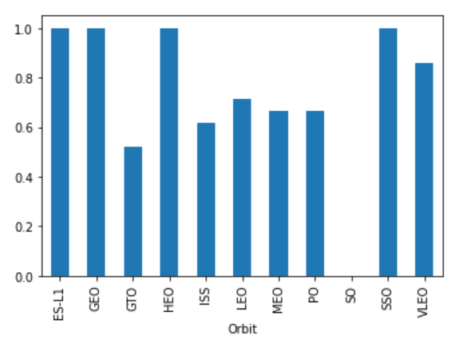
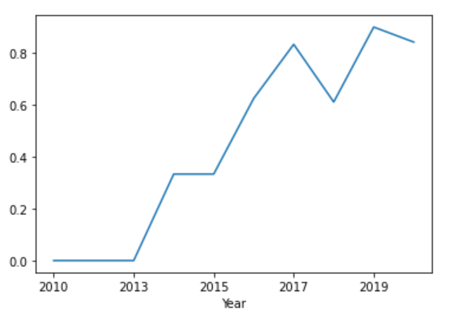
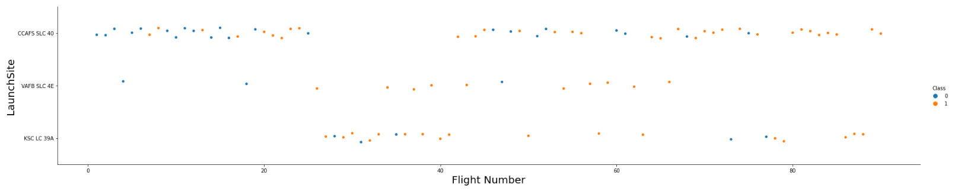
EDA with Data Visualization
We used scatter chart to analyze the correlation between two sets of data
And we used bar chart to analyze the distribution of a certain data
We also used the line graph to analyze the variation trend of data.
EDA with Data Visualization (notebook URL)
And here are a few examples:

Slide 12
EDA with SQL
EDA with SQL (notebook URL)
The following SQL queries are performed for data analysis:
Display the names of the unique launch sites in the space mission
Display 5 records where launch sites begin with the string 'CCA’
Display the total payload mass carried by boosters launched by NASA (CRS)
Display average payload mass carried by booster version F9 v1.1
List the date when the first successful landing outcome in ground pad was acheived
List the names of the boosters which have success in drone ship and have payload mass greater than 4000 but less than 6000
List the total number of successful and failure mission outcomes
List the names of the booster_versions which have carried the maximum payload mass
List the failed landing_outcomes in drone ship, their booster versions, and launch site names for in year 2015
Rank the count of landing outcomes (such as Failure (drone ship) or Success (ground pad)) between the date 2010-06-04 and 2017-03-20, in descending order

Slide 13
Build an Interactive Map with Folium
An Interactive Map with Folium (notebook URL)
Mark all launch sites’ positions to show their absolute position on the map
All sites are color-coded to indicate whether they launched successfully
Straight lines are drawn to indicate the distance from a launch site to the nearest coastline, highway, railway, or city

Slide 14
Build a Dashboard with Plotly Dash
Dashboard with Plotly Dash (notebook URL)
Added Launch Sites Dropdown List to enable Launch Site selection
Added a pie chart to show the Success vs Failed counts for the selected site
Added a slider to select Payload range
Added a scatter chart to show the correlation between Payload and Launch Success

Slide 15
Predictive Analysis (Classification)
Loading data and preprocessing data
Predictive Analysis (notebook URL)
Used scikit-learn to preprocess the data and build the models
Used GridSearch to find the best model
Building models and Using GridSearchCV function
Using training data to train the model
Using test sets to evaluate models

Slide 16
Results
Exploratory data analysis results
The success of the launch depends on the features of payload, rocket type, launch orbit, launch time and so on.
We should mainly consider the above features to predict the results.
Interactive analytics demo in screenshots
The launch sites are concentrated in open areas near the coastline.
Whether the launch site was on the east or west coast had no significant effect on the results.
Predictive analysis results
The prediction accuracy of several kinds of machine learning models reaches more than 80%, which has good prediction ability.

Slide 17

Section 2

Slide 18
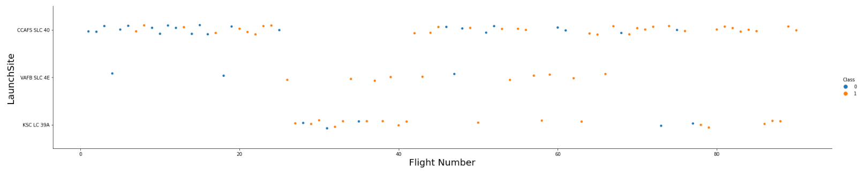
Flight Number vs. Launch Site
Blow is a scatter plot of Flight Number vs. Launch Site, and we can find that:
The number of launches from site CCAFS SLC 40 is the largest, followed by site KSC LC 39A and site VAFB SLC 4E.
The smaller Flight Number is mostly launched from site CCAFS SLC 40

Slide 19
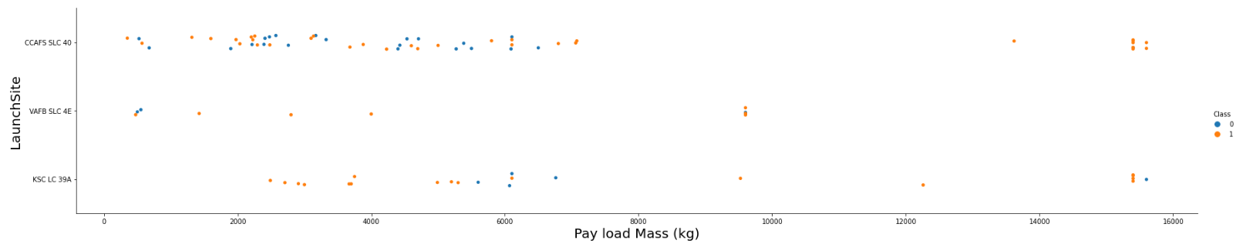
Payload vs. Launch Site
Blow is a scatter plot of Payload vs. Launch Site, and we can find that:
There are more launches for small Payloads and fewer launches for large Payloads.
Large Payloads have fewer failures.

Slide 20
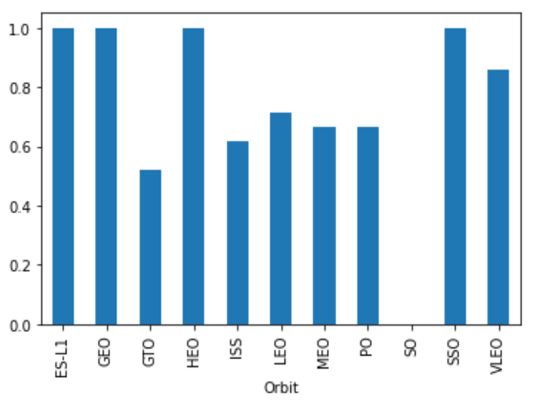
Success Rate vs. Orbit Type
Blow is a bar chart for the success rate of each orbit type
The success rate to orbit ES-L1, GEO, HEO and SSO was 100%.
Except for the SO orbital, the success rate of all the other orbits is over 50%

Slide 21
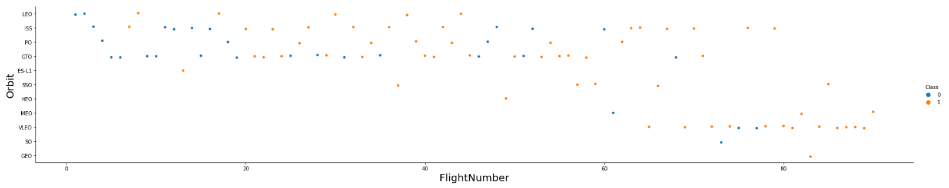
Flight Number vs. Orbit Type
Blow is Show a scatter point of Flight number vs. Orbit type
The smaller Flight Number is mostly concentrated in the LEO, ISS, PO and GTO.
The larger Flight Number is mostly concentrated in the VLEO and ISS.

Slide 22
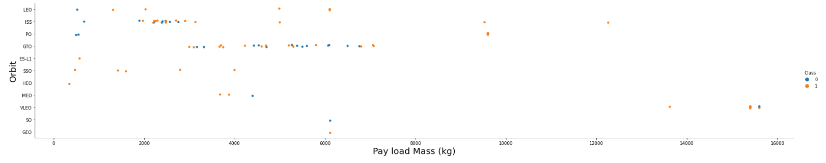
Payload vs. Orbit Type
Blow is a scatter point of payload vs. orbit type
There are only VLEO and ISS orbits for the launch of heavy Payloads.
Most orbits have little variation in Payloads.

Slide 23
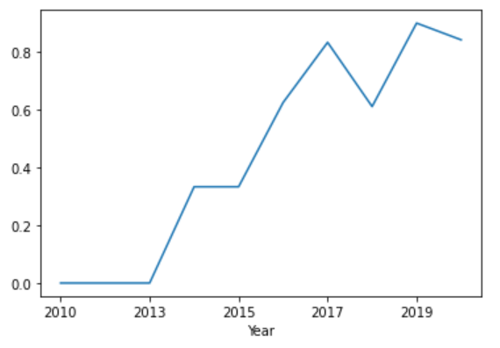
Launch Success Yearly Trend
Blow is a line chart of yearly average success rate
With the increase of years, the success rate of the launch on the whole shows an increasing trend.
By 2019, its launch success rate had exceeded 80%.

Slide 24
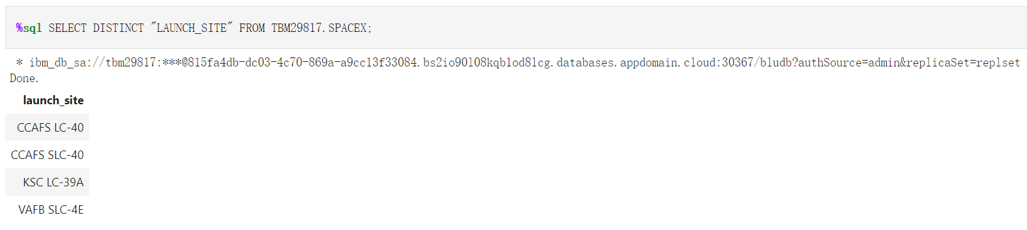
All Launch Site Names
Find the names of the unique launch sites
We can see that there are four sites in total, which are CCAFS LC-40, CCAFS SLC-40, KSC LC-39A and VAFB SLC-4E.

Slide 25
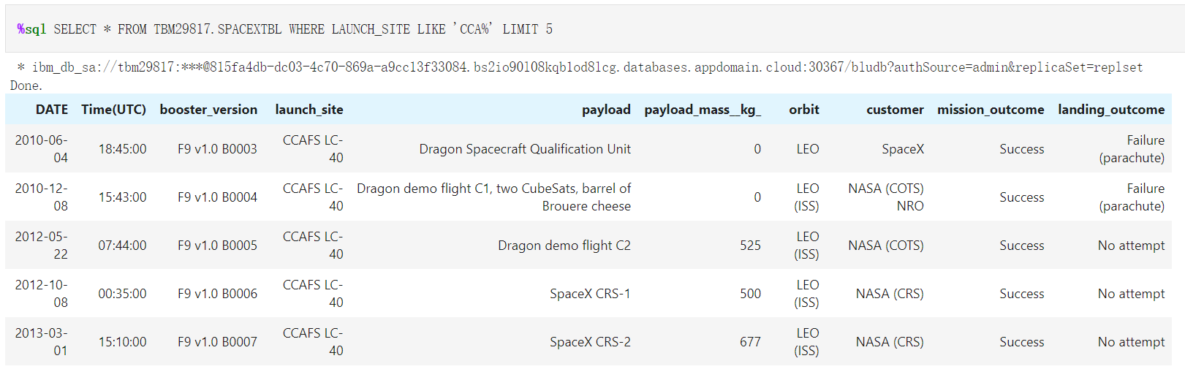
Launch Site Names Begin with 'CCA'
Find 5 records where launch sites begin with `CCA`
We can see that there are five records in total.

Slide 26
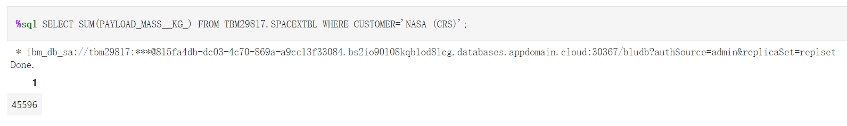
Total Payload Mass
Calculate the total payload carried by boosters from NASA
We can see that the total payload carried by boosters from NASA is 45,596 kg.

Slide 27
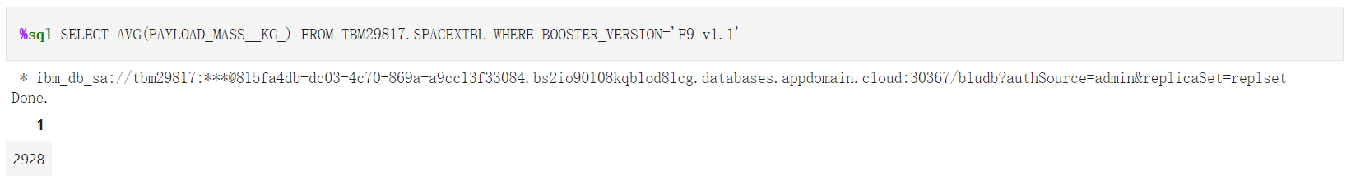
Average Payload Mass by F9 v1.1
Calculate the average payload mass carried by booster version F9 v1.1
We can see that the average payload mass carried by booster version F9 v1.1 is 2,928 kg.

Slide 28
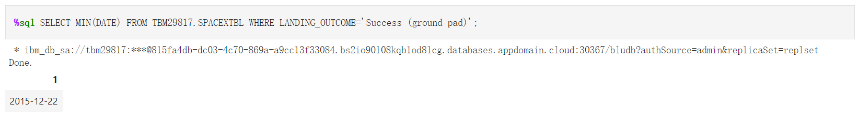
First Successful Ground Landing Date
Find the dates of the first successful landing outcome on ground pad
We can see that the dates of the first successful landing outcome on ground pad is ‘December 22, 2015’.

Slide 29
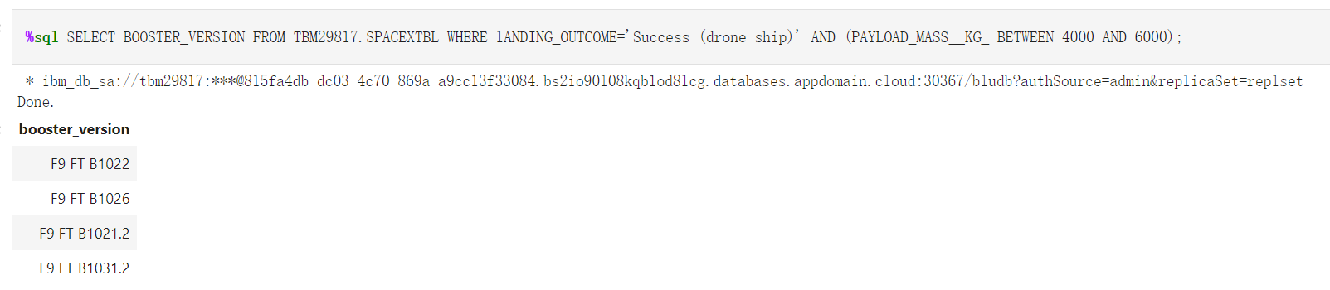
Successful Drone Ship Landing with Payload between 4000 and 6000
List the names of boosters which have successfully landed on drone ship and had payload mass greater than 4000 but less than 6000
We can see that there are four boosters in total, which are F9 FT B1022, F9 FT B1026, F9 FT B1021.2 and F9 FT B1031.2.

Slide 30
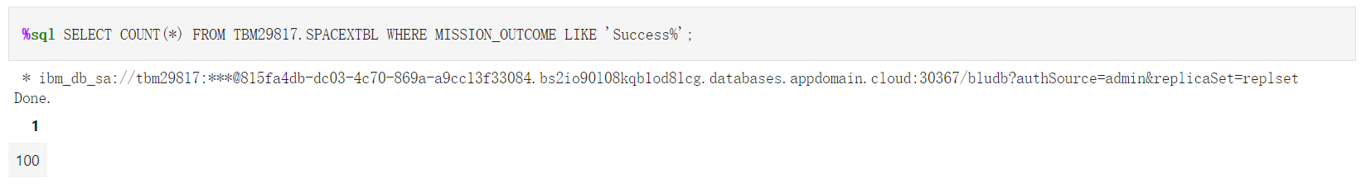
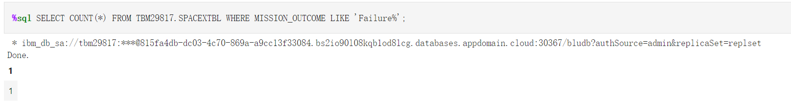
Total Number of Successful and Failure Mission Outcomes
Calculate the total number of successful and failure mission outcomes
We can see that the total number of successful mission outcomes is 100.
And the total number of failure mission outcomes is 1.

Slide 31
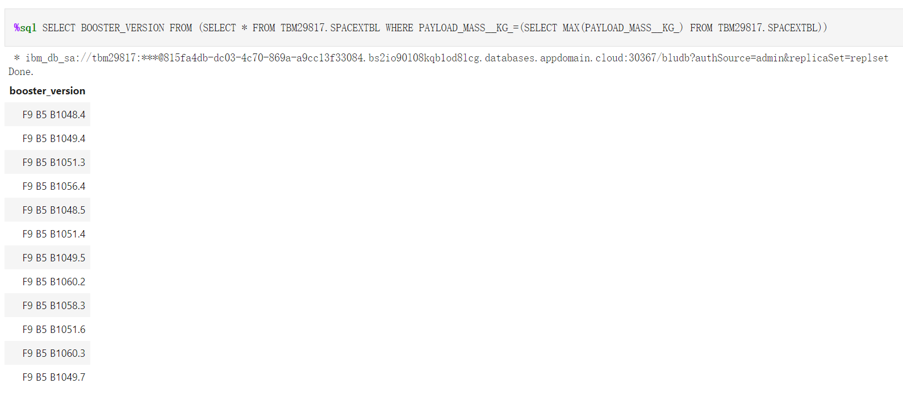
Boosters Carried Maximum Payload
List the names of the booster which have carried the maximum payload mass
Here are the names of the booster which have carried the maximum payload mass

Slide 32
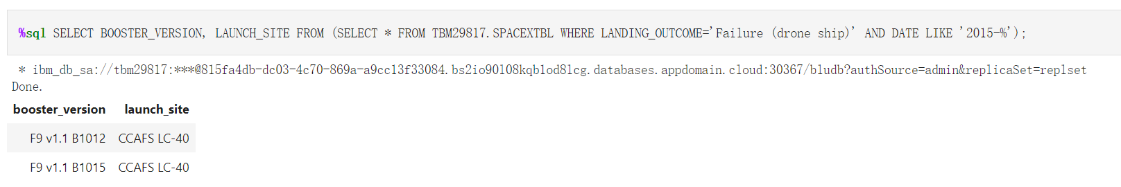
2015 Launch Records
List the failed landing_outcomes in drone ship, their booster versions, and launch site names for in year 2015
We can see that there are two records which failed landing_outcomes in drone ship.

Slide 33
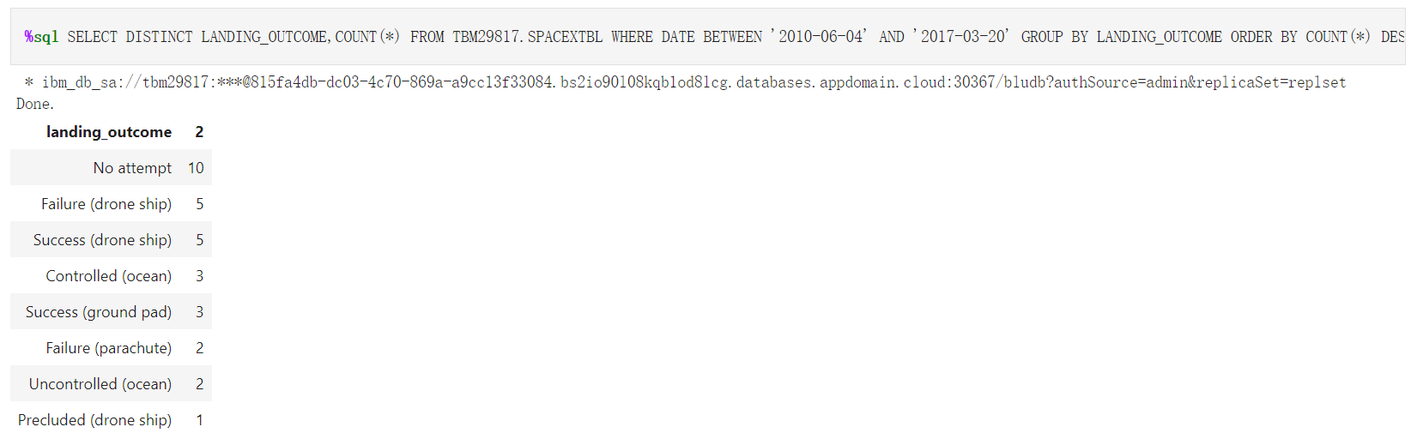
Rank Landing Outcomes Between 2010-06-04 and 2017-03-20
Rank the count of landing outcomes (such as Failure (drone ship) or Success (ground pad)) between the date 2010-06-04 and 2017-03-20, in descending order
At most is ‘No attempt’.
On the drone ship, the number of failures and successes is equal.

Slide 34

Section 3

Slide 35
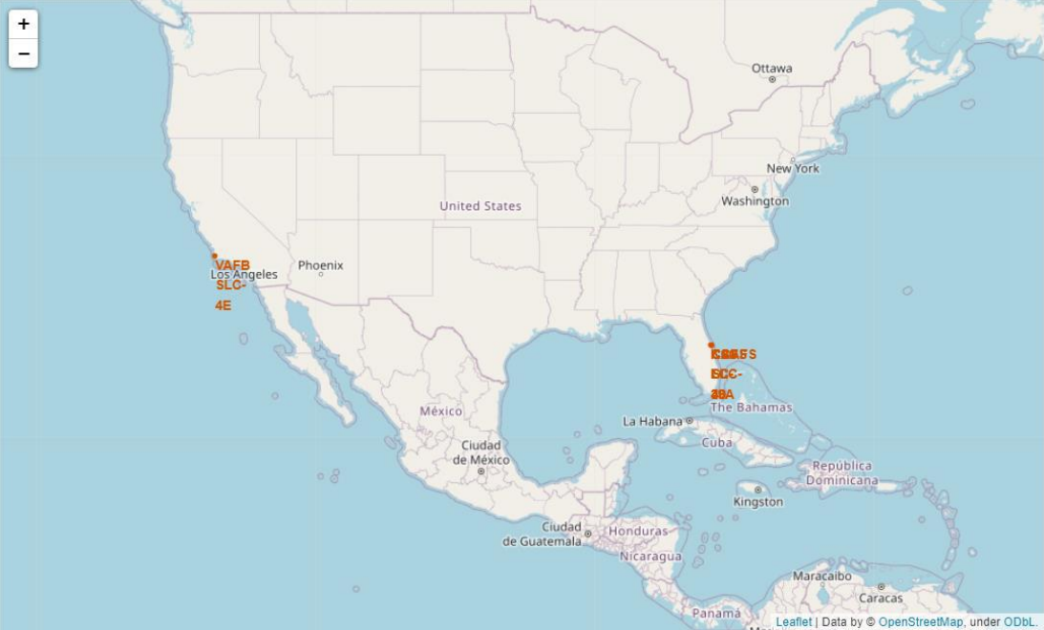
All launch sites’ locations on a global map
The orange points are the launch sites’ locations and we can see that:
They are mainly concentrated in two areas.
They lie in the proximity of equator.
They lie in close proximity to the coastline.

Slide 36
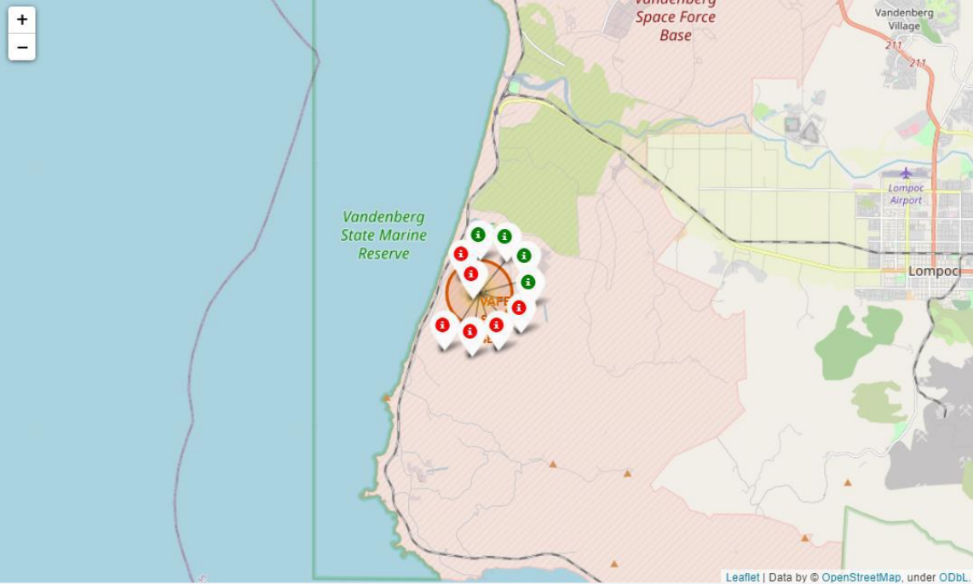
Success and failed launches for each site
The Blow right picture shows the outcome of VAFBSLC-4E launch site.
The green marker indicates a successful launch while the red marker indicates unsuccessful launch.
We can see that the successful rate is 40% in this launch site.

Slide 37
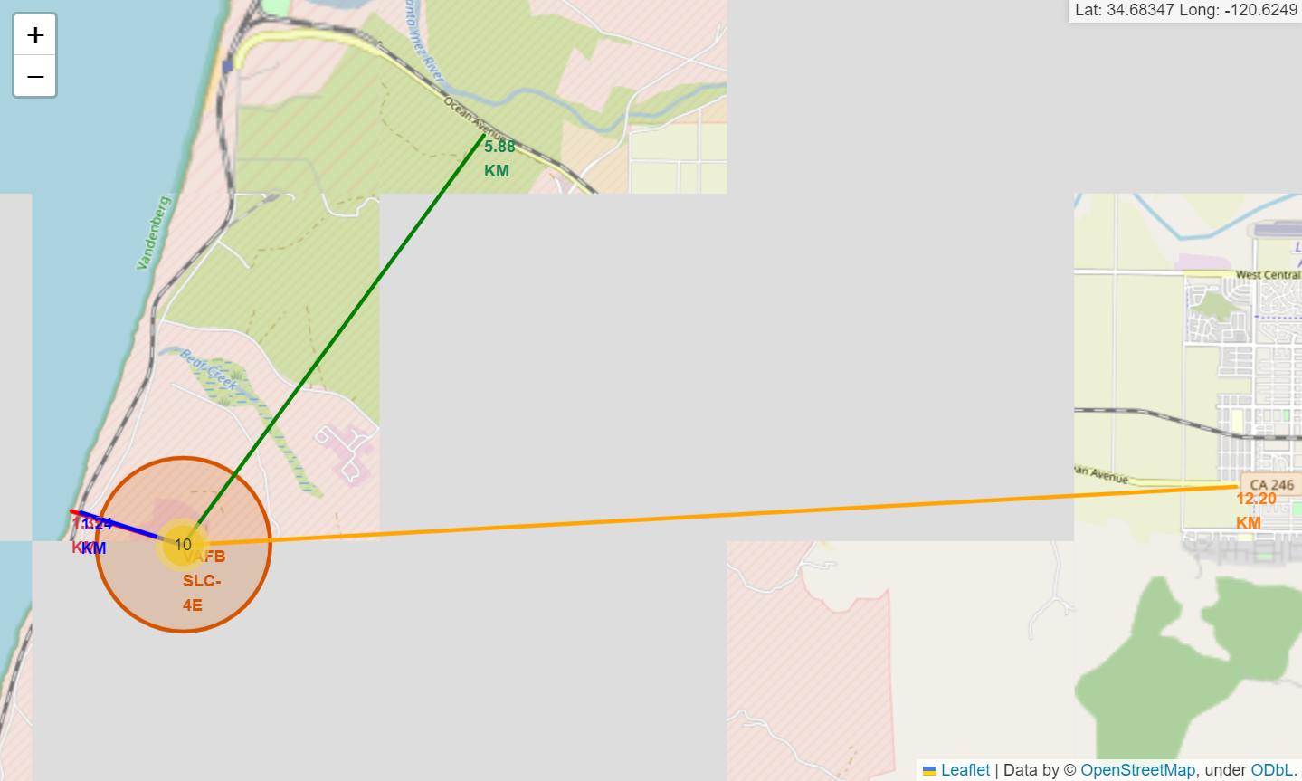
Distance from launch site to its proximities
The four lines in the figure below show the distance from VAFBSLC-4E launch site to four nearby locations, and we can see that:
VAFBSLC-4E launch site is very close to coastline and railway, and relatively far from the city.

Slide 38

Section 4

Slide 39
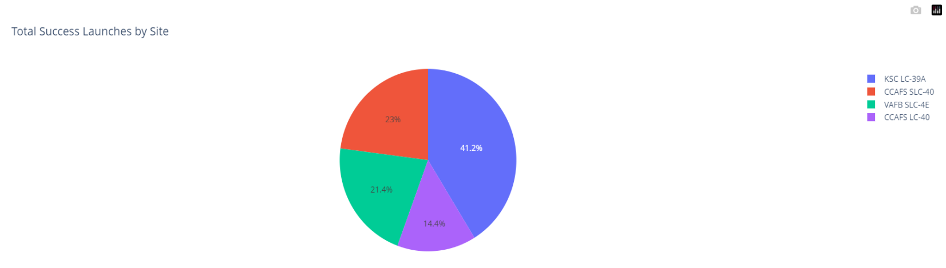
Total Success Launches by Site
The blow pie chart shows the total success launches by all sites, and we can see that:
KSC LC-39A launch site has the highest success rate.
And CCAFS LC-40 launch site has the lowest success rate.

Slide 40
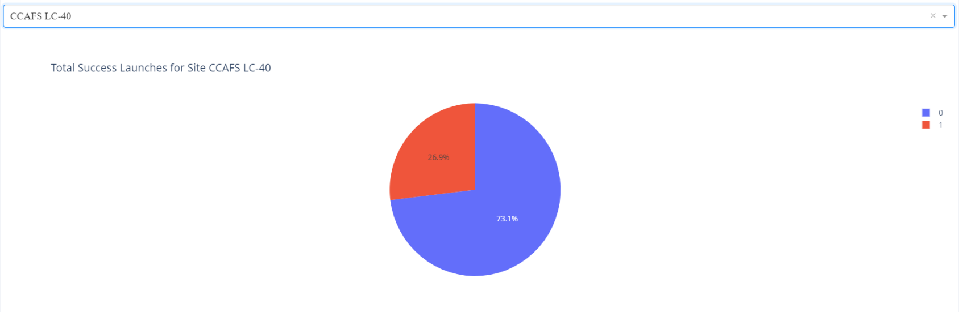
The launch success rate of site CCAFS LC-40
The blow pie chart shows the success rate of site CCAFS LC-40, and we can see that:
The launch success rate at site CCAFS LC-40 was only 26.9%.

Slide 41
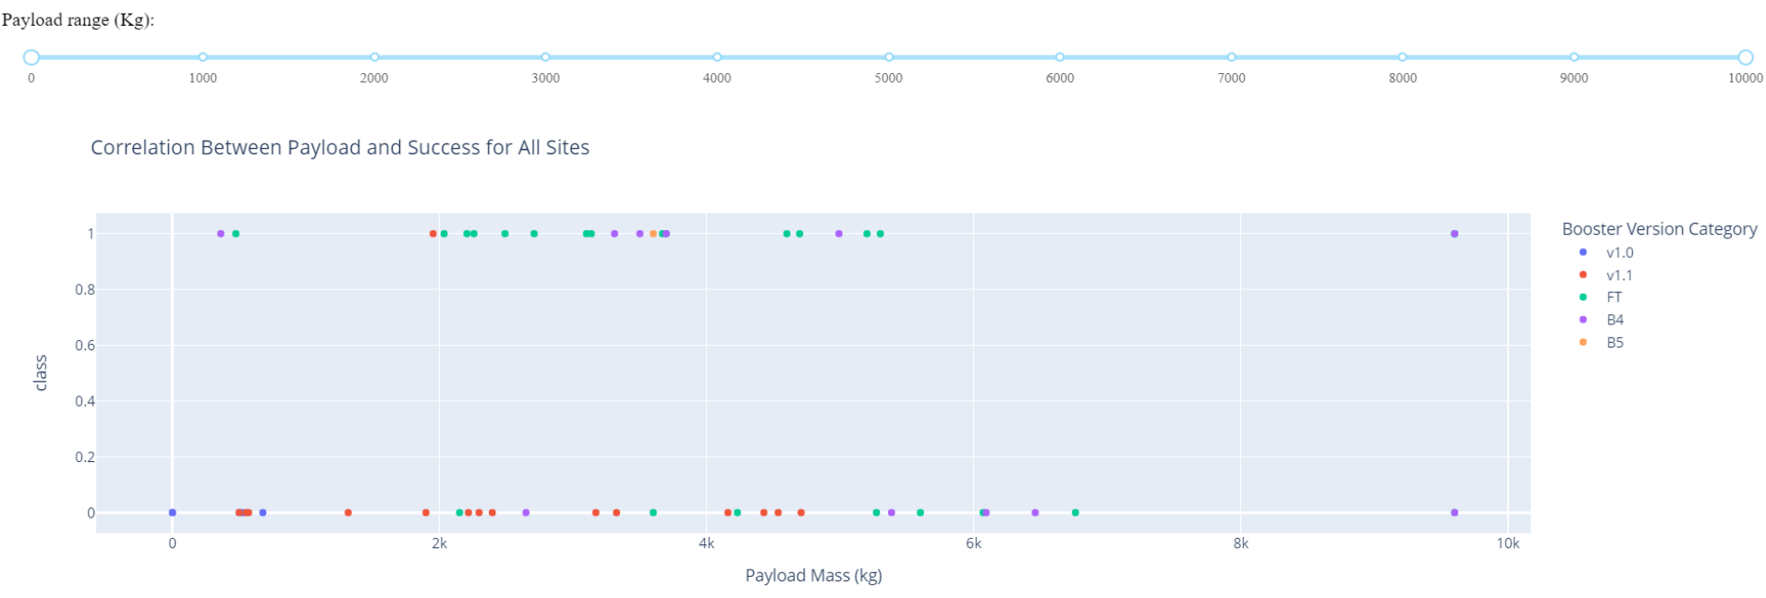
Correlation Between Payload and Success
The blow scatter plot shows the Correlation Between Payload and Success, and we can see that:
The Payload of a successful rocket is concentrated between 2k and 6k.

Slide 42

Section 5

Slide 43
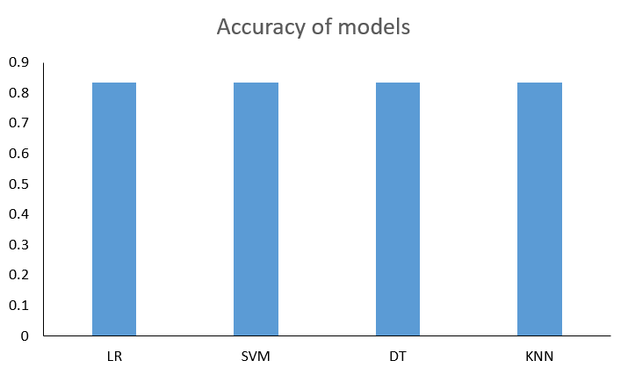
Classification Accuracy
The right bar chart is the Test Accuracy of the trained models.
The accuracy of all four models was 83.33%.

Slide 44
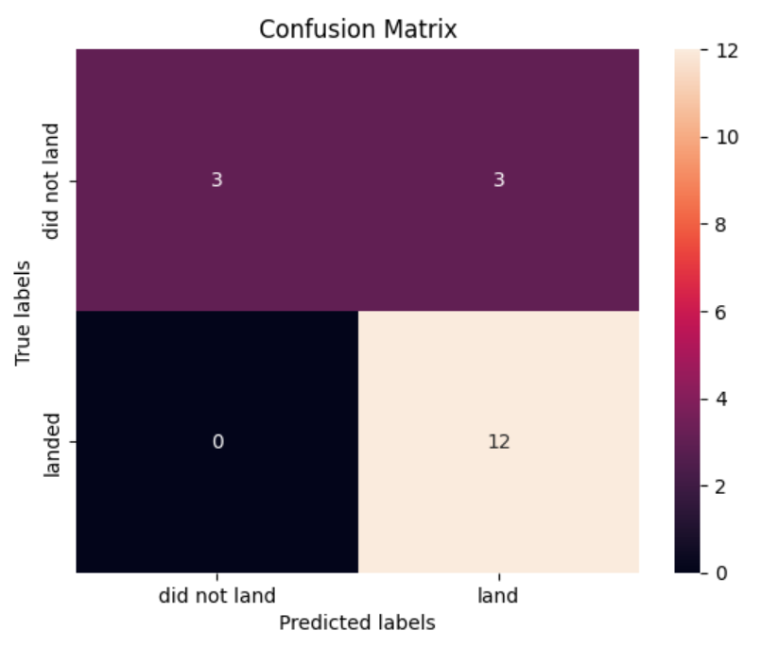
Confusion Matrix
The right side shows the Confusion Matrix of the Logistic Regression.(Confusion Matrix is the same for all four models)
We see that the major problem is false positives, The three samples of prediction errors are all false positives.

Slide 45
Conclusions
The success of the launch depends on the features of payload, rocket type, launch orbit, launch time and so on.
The prediction accuracy of several kinds of machine learning models reaches more than 80%, which has good prediction ability.
The models major problem is false positives, which means that the models tend to make positive predictions. This results in actual costs that are higher than the prediction costs.

Slide 46


